Slide 1

STOCK PRICE PREDICTION
CMR COLLEGE OF ENGINEERING & TECHNOLOGY
Kandlakoya, Medchal, Hyderabad - 501401
Department of Computer Science and Engineering
21H51A66B0 - U SAI ASHISH
21H51A66B1 - V YESHWANTH
21H51A66C9 - N SHIVAMANI
Under esteemed guidance of
Guide Name – Mr. Mahendra Reddy
Designation

Slide 2
Contents
Abstract
Introduction
Motivation of study
Objectives
Scope and limitation of study
Literature survey
Existing system/Methods
Data collection and performance metrics
Study of performance
Proposed system architecture
Method description
Implementation and results
Performance analysis
Conclusion &future work

Slide 3
Abstract
Stock price prediction is integral to forecasting future data trends through the utilization of machine learning or deep learning technologies. This project focuses on constructing a predictive model by employing classification methods, It uses Random Forest classifier for prediction. The approach involves training the model with historical data, incorporating essential financial indicators and past stock prices. By integrating essential financial indicators and past stock prices, the model undergoes training and evaluation for short-term forecasting. The algorithmic selection is crucial, emphasizing accuracy, response time optimization, and segmentation for effective prediction. The project aims to deliver a technically robust foundation for stock price forecasting, emphasizing the importance of algorithmic considerations in achieving the best possible predictions.

Slide 4
Introduction
We aim to develop a model that can predict and forecast future data trends through the utilization of machine learning.
This project focuses on constructing a predictive model by employing classification methodologies, using Random Forest Classification and basic time-series models. The approach involves training the model with historical data, incorporating essential financial indicators and past stock prices. By integrating essential financial indicators and past stock prices, the model undergoes training and evaluation for short-term forecasting.
The project aims to deliver a technically robust foundation for stock price forecasting, emphasizing the importance of algorithmic considerations in achieving the best possible predictions.

Slide 5
Motivation of study
The ability to anticipate and respond to stock price movements is a crucial element for investors and traders. The motivation behind this project is to enhance decision-making processes in the financial domain. we aim to use methods from machine learning to predict the data as accurate as possible unlike the traditional methods.
Successful stock price prediction can provide valuable insights for optimizing portfolio allocation, identifying opportune moments to buy or sell, and ultimately mitigating financial risks.

Slide 6
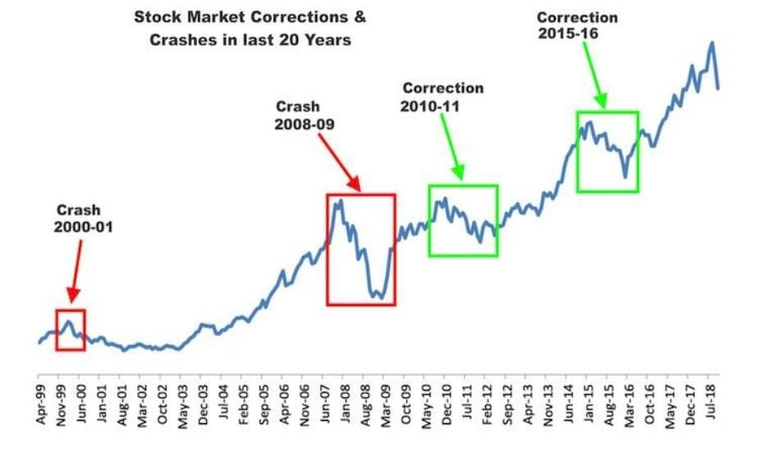

Slide 7
Objectives
To generalize the application of the existing system, our work uses the system to estimate other stocks in similar emerging markets and mature markets.
The system can be extended to analyze multivariate time series data and import raw dataset directly.
Profit can be maximized even when the corporate stock market is has lower value.
The development of a web-based application has been considered to improve the user-friendliness and usability of the expert system.

Slide 8
Scope of study
Scope
Real-time predictions
Updating the model with latest market data for more accurate predictions.
Improvements
Tune parameters to optimize performance and reduce risk of overfitting.
Risk management
Contribute to risk management frameworks by providing tools for assessing and mitigating potential financial risks associated with stock investments.
Adaptability to Different Markets
Design the project to be adaptable to different stock markets, allowing for potential expansion and application in diverse financial environments.

Slide 9
Limitations of study
Limitations
Model Complexity
Increase in complexity of data may pose risk to the models decision making process
Overfitting Risks
There is a potential risk of overfitting.
Data Quality
The accuracy of predictions is contingent on the quality of historical data, and any inaccuracies or missing information in the dataset may affect the model's performance.
No Guarantee of Profitability
The project does not guarantee profitable outcomes in stock trading, and users should exercise caution

Slide 10
Literature survey
Research on Stock Price Prediction Method Based on Convolutional Neural Network, IEEE 2019- Sayavong Lounnapha.
This model is based on CNN to predict data.
An LSTM-Method for Bit-coin Price Prediction: A Case Study Yahoo Finance Stock Market, IEEE 2019- Ferdiansyah.
This model uses recurrent neural network(RNN). It also uses the root mean square Error(RMSE).

Slide 11
Existing Methods
Support vector regression (SVR) a variant of SVM, is typically used to solve non linear regression problems by constructing input output mapping function
The least squares support vector regression (LSSVR) algorithm is a further development of SVR and it uses considerably reduces computational complexity and increases efficiency compared to standard SVR
The firefly algorithm (FA), which is a nature inspired metaheuristic method has recently performed extremely well in solving various optimization problems.

Slide 12
data collection and performance metrics
Size of data set
Historical Timeframe
collecting data spanning a significant historical timeframe, such as several years. This allows the model to capture various market conditions and trends. Our project takes 10 years of dataset.
Number of Features
Include a sufficient number of features relevant to stock price prediction, such as opening price, closing price, high and low prices, trading volume, and any additional technical indicators.

Slide 13
Study of performance
Accuracy Analysis
Assess the overall correctness of the model's predictions. While accuracy is a fundamental metric, it's crucial to verify the reported accuracy of 55% through detailed analysis.
Precision and Recall Assessment
Examine the precision and recall values, particularly if there are imbalances in the classes. A balanced approach is essential to avoid focusing solely on one aspect at the expense of the other.

Slide 14
Proposed system architecture
Data Collection
Obtain historical stock data using yfinance.
Feature Engineering
Create new predictors and features.
Model Training
Utilize RandomForestClassifier from scikit-learn.
Backtesting
Evaluate model performance on historical data.
Prediction for the Future
Forecast future stock prices based on trained model.

Slide 15
Method description
Data Collection
Utilize the yfinance library to fetch historical stock data for the S&P 500 index.
Feature Engineering
Create new predictors and features, including rolling averages and trends for different time horizons.
Model Training
Train a RandomForestClassifier using historical data and selected predictors.
Backtesting
Assess the model's performance on historical data to understand its accuracy and precision
Predicting Future Stock Prices
Extend the model to predict future closing prices based on new features and historical patterns.

Slide 16
Implementation and Results
Implementation
Display snippets of Python code for key functionalities (data retrieval, model training, future prediction)
Results
Showcase backtesting results and precision scores.
Present predicted future closing prices compared to actual prices.
In our model we get an output of 0 and 1. If there is a constant flow or downfall of stock price it gives and output of 0 and 1 represents rise of stock price.

Slide 17
performance analysis
Proposed method performance
-As Random Forest is a classifier that contains a number of decision trees on various subsets of the given dataset and takes the average to improve the predictive accuracy of that dataset
-With the help of Random the risk of overfitting is reduced.
Existing methods performance on data set
-Overfitting occurs in the present existing models. And their accuracy is not upto mark due to this overfitting issue

Slide 18
Conclusion & future work
-Our model demonstrates robust performance in predicting stock prices, as evidenced by backtesting and comparison metrics.
-Achieves high precision, indicating reliable predictions for decision-making in financial markets.
Future Work
-Real-time Implementation
Adapt the model for real-time prediction, enabling timely decision-making in dynamic market conditions.
- User Interface Development
Develop an intuitive user interface for broader accessibility, facilitating usage by financial analysts and investors.

Slide 19
Thank you ☺

